Slide 1

Azure Developer – Virtual Mentored Program
Azure DevOps, Jenkins, and Azure Active Directory

Slide 2
Week 7 Content
Azure DevOps
Jenkins
Azure Active Directory

Slide 3
Azure DevOps

Slide 4




Azure DevOps (ADO)
Platform provided by Microsoft to help development teams collaborate end-to-end
Supports concepts of organizations, projects, and issues
Issue types can include epics, user stories, bugs, spikes, etc.
Supported in two main “flavors” – Azure DevOps Services (in the Cloud) and Azure DevOps Server (on-prem)
Notes:
Epics can be used to group sets of issues under a common heading (often used to describe entire features)
User stories – define the requirements often using a form of Given | When | Then syntax
Spikes – tasks wholly-devoted to research on a concept/topic, the results of which can be used to inform other work tasks

Slide 5





Components of Azure DevOps

Slide 6
Components of Azure DevOps
Provides planning and tracking support for project work
Can be used to manage both Kanban and Scrum efforts

Slide 7
Components of Azure DevOps
Provides rich source control support for code and code artifacts
Can be used to track both Git as well as Team Foundation Version Control (TFVC) repositories
Notes:
TFVC – Microsoft-specific (supports migration from TFS)

Slide 8
Components of Azure DevOps
Provides build and release services
Supports both Continuous Integration (CI) and Continuous Deployment (CD)

Slide 9
Components of Azure DevOps
Allows hosting/sharing of source code packages
Supports both public and private sources
Includes storage for build artifacts from CI builds, NuGet, npm, Maven, PyPI, etc.

Slide 10
Components of Azure DevOps
Provides tools for multiple types of testing on your projects
Includes support for manual as well as automated (continuous) testing
Can be used by project teams to manage test plans, test cases, test artifacts, and test results – all in a single location

Slide 11
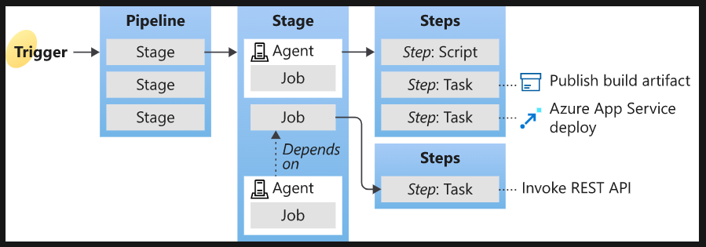
CI/CD in Azure DevOps
Source: https://learn.microsoft.com/en-us/azure/devops/pipelines/get-started/key-pipelines-concepts?view=azure-devops
Notes:
Showing here for Azure DevOps but will be very similar in a Jenkins implementation

Slide 12
Integrating Automated Tests Into Azure DevOps Pipeline
In Azure DevOps, you can add a task to your pipeline to automatically run tests as part of pipeline execution
Mechanism used will depend on the language your app is written in
Often test execution will be handled with a script command used to launch the defined set of automated tests
Gates can be put in place to prevent move from build to release if tests fail

Slide 13
Integrating Automated Tests Into Azure DevOps Pipeline
Demo
Notes:
https://learn.microsoft.com/en-us/training/modules/run-quality-tests-build-pipeline/

Slide 14
Integrating Azure Key Vault Into Azure DevOps Pipeline
Azure DevOps includes tasks for integrating with an Azure Key Vault instance
Can be used to dynamically apply sensitive configuration at build/release time (in pipeline) vs. checking in to source control
In Azure DevOps, there’s a UI to help guide configuration of the integration or you can edit the YAML directly
You’ll need to grant the pipeline access to the secret in Key Vault – accomplished through use of a service principal

Slide 15
Integrating Azure Key Vault Into Azure DevOps Pipeline
Demo
Notes:
https://learn.microsoft.com/en-us/azure/devops/pipelines/release/azure-key-vault?view=azure-devops&tabs=yaml + https://learn.microsoft.com/en-us/azure/active-directory/develop/howto-create-service-principal-portal#register-an-application-with-azure-ad-and-create-a-service-principal

Slide 16
Add Deploy Stage & Push to Azure Resources
Demo
Notes:
https://learn.microsoft.com/en-us/azure/devops/pipelines/apps/cd/deploy-docker-webapp?view=azure-devops&tabs=python%2Cyaml

Slide 17
Jenkins

Slide 18
Deploy Jenkins to Azure VM
Lab
Notes:
https://learn.microsoft.com/en-us/azure/developer/jenkins/configure-on-linux-vm
Use openjdk-11-jdk in custom-data file.
On VM create statement add --size Standard_B2s
Try exercises at https://github.com/PacktPublishing/Continuous-Delivery-With-Docker-and-Jenkins-3rd-Edition/tree/main/Chapter04 if time left over

Slide 19
Azure Active Directory

Slide 20
What is it?
Provides cloud-based IAM (Identity & Access Management)
Enables integrated access to several Microsoft platforms (including Azure, Microsoft 365, etc.) as well as linking with multiple SaaS applications
Organized by tenant – represents an organization and helps with managing internal & external user access to resources
Supports several license types defining levels of access to more advanced capabilities

Slide 21
What is it?
Built around industry standards (like OAuth 2.0, OpenID Connect, and SAML v2.0)
Supports multiple identity types – work or school accounts, personal Microsoft accounts, and social accounts (Facebook, Google, Twitter, etc.)
Provides open-source libraries to facilitate programmatic integration
Portal for managing application registrations (more to come on that)
Provides APIs to support automatic registration of applications as part of CI/CD pipelines

Slide 22
What is it?
License types supported include Free, Office 365, Premium P1, and Premium P2
As expected, the Premium license versions offer more IAM capability but also cost more
Finally, Azure AD provides B2B and B2C offerings to support access for internal/external users and SSO

Slide 23
Managing Application Registrations
Demo

Slide 24




Thank you!
If you have additional questions, please reach out to me at:
(email address)
Notes:
Mandatory -- Need bookend -- first and last thing they should see is DevelopIntelligence
ACTION: Use this for the final slide of your class materials. Include contact information so participants can reach you if they have questions after the course.

